Slide 1
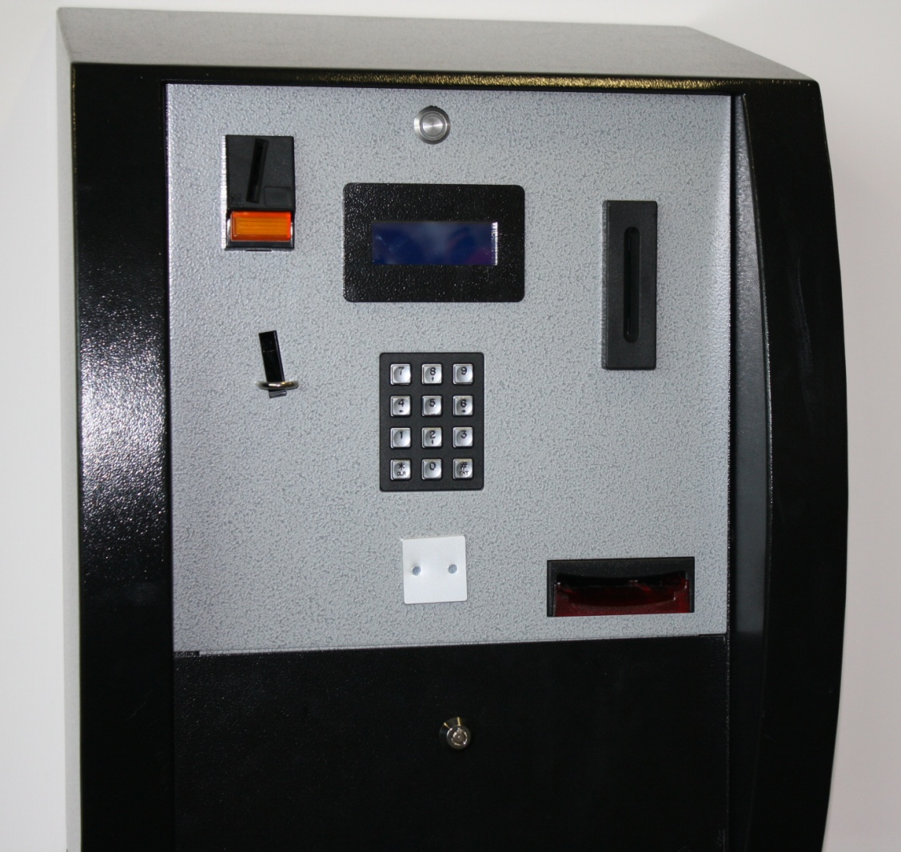
3. Remove your card.
2. Your details are shown on screen.
1. Place your card in the slot.
4a. Insert coins here
Reset button
5. Press the reset button.
4b. Insert notes here
If you experience problems go immediately to main reception.
To check our balance insert your card, read the screen and press reset

