Slide 1
Year 10 Parents’ Revision Workshop
26th March 2013

Slide 2
Clip 1
Neil

Slide 3
The Reluctant Learner

Slide 4
Clip 2
Escalator

Slide 5

Activity 1 – Word Recall

Slide 6






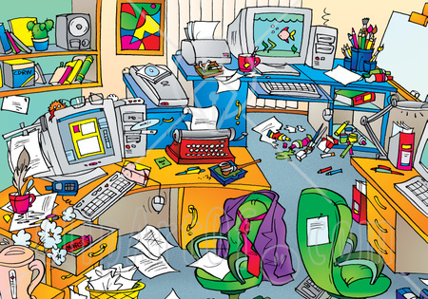


Causes of Poor Concentration
Vocabulary Difficulties
Conceptual Difficulties
Inappropriate Reading Speed
Distraction
Poor Organisation
Lack of interest
Lack of motivation

Slide 7


Speed read ing has be en found to be bet ter for understand ing than slow read ing

Slide 8
KNOW YOURSELF
The self doubter
The perfectionist
The rebel
The excessive socialiser
The daydreamer

Slide 9
Activity 2 – What type of learner are you?

Slide 10
Poem
I must go down to the seas again
To the lonely sea and the sky
I left my shirt and pants there
I wonder if they are dry.
                Spike Milligan

Slide 11
How did you do?

Slide 12
Planning

Slide 13



Slide 14
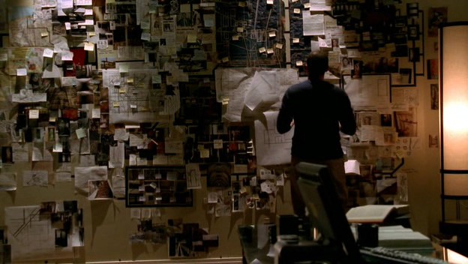

Slide 16
Resouces
http://www.bbc.co.uk/schools/gcsebitesize/maps/index.shtml
Moodle
Exam board websites – past papers
Booklet

Slide 17
Clip 3
Mr Bean

Slide 18
Why this now?
Year 10 exams
2 weeks – starting 13th May 2013

Slide 19
Q: "What is the difference between 8 and 5?"
A: "8 is round on top, and 5 is flat."

Slide 20

Q: ..........................
You must show your working.
A:

Slide 21
