Slide 1

GCSE English or English Language & English Literature

Slide 2
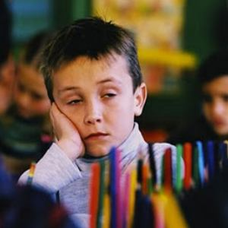

Familiar?
I haven’t got any homework...
You can’t revise for English...

Slide 3

A Long, Long Time Ago in A Far, Far Away Galaxy...
So, Adam, are you going to be revising tonight?
Sir, do look stupid?

Slide 4
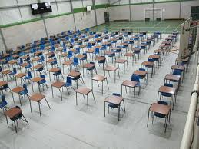
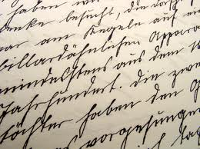

Myths...
..you can’t revise.
..handwriting.
..spelling.

Slide 5
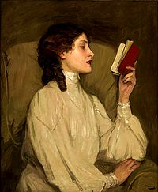

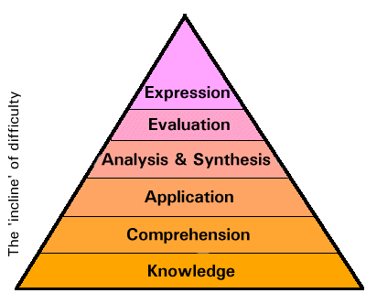
Skills...
Developing interpretations
of symbolic meanings of texts
Finding an Individual Voice
Analysing Language,
Form & Structure
Whole-Text Organisation
Inferring and Deducing
Extended, Developed
Written Pieces
Finding Quotes
Grammar (Advanced)
Understanding what you’ve read
Spelling & Vocabulary

Slide 6
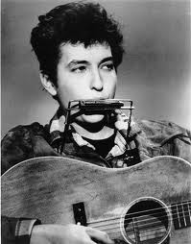
The Times They Are A-Changin’
English GCSE
5 Controlled Conditions Coursework
One exam
English Language & English Literature
5 Controlled Conditions Coursework
3 exams

Slide 7
Choice
Contains BOTH Literature and Language

Slide 8


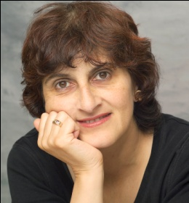
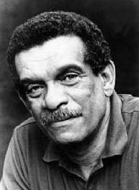
English GCSE
Unit | Content
1 | Non-Fiction Exam
2 | Unit Two – Speaking and Listening
3 | Understanding written texts and writing creatively
  Two pieces of creative writing
  Shakespeare
  Great Expectations
  Poetry from Different Cultures
vs.
Moniza Alvi
Derek Walcott

Slide 9


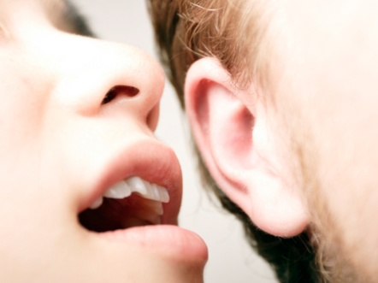
English Language
Unit | Content
1 | Non-Fiction Exam
2 | Speaking and Listening
3 | Understanding written texts and writing creatively
  3a Extended Reading
  3b Producing Two Creative Texts
  3c Spoken Language Unit

Slide 10



English Literature
Unit | Content
1 | Exploring Modern Texts (Exam) A - Modern prose or drama B – Exploring cultures
2 | Poetry (Exam)
3 | Shakespeare and English Literary Heritage
vs.
Notes:
A

Slide 11
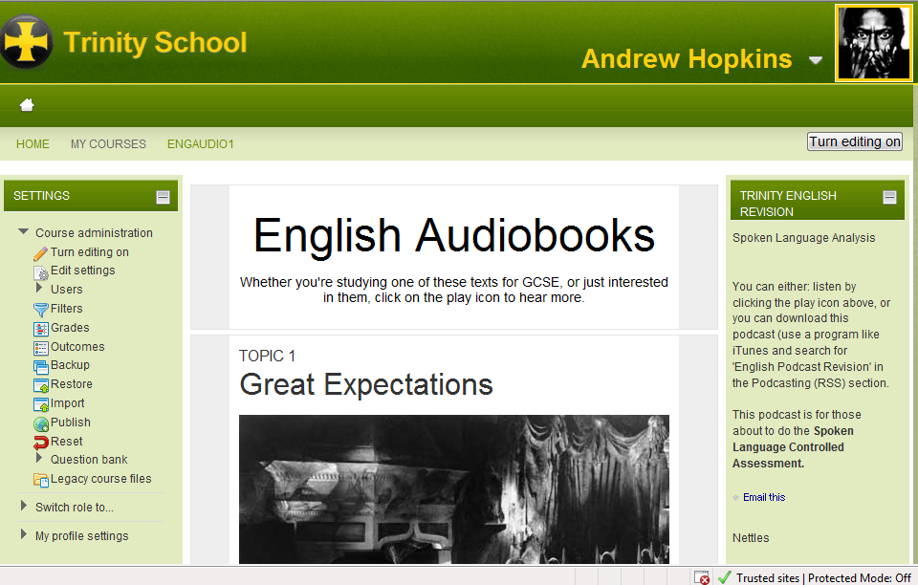
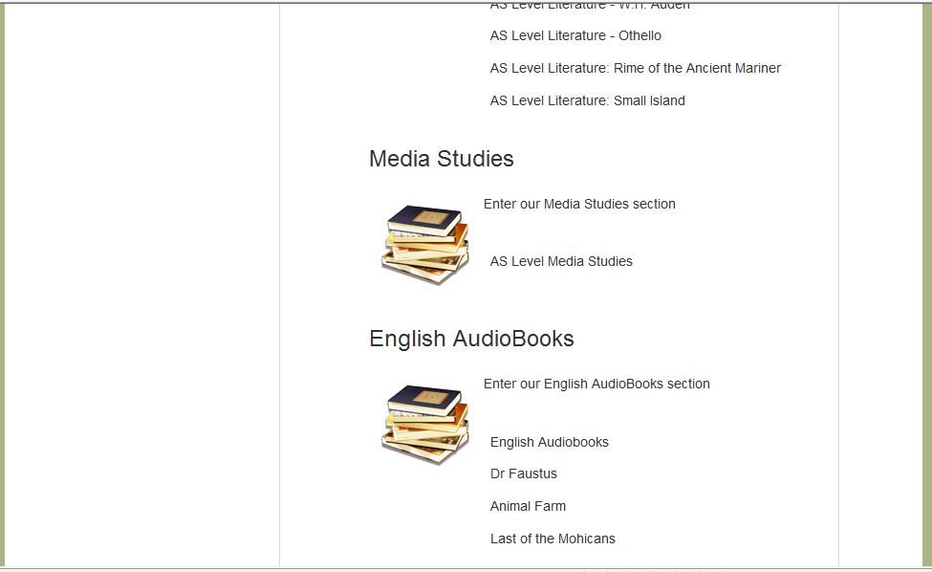
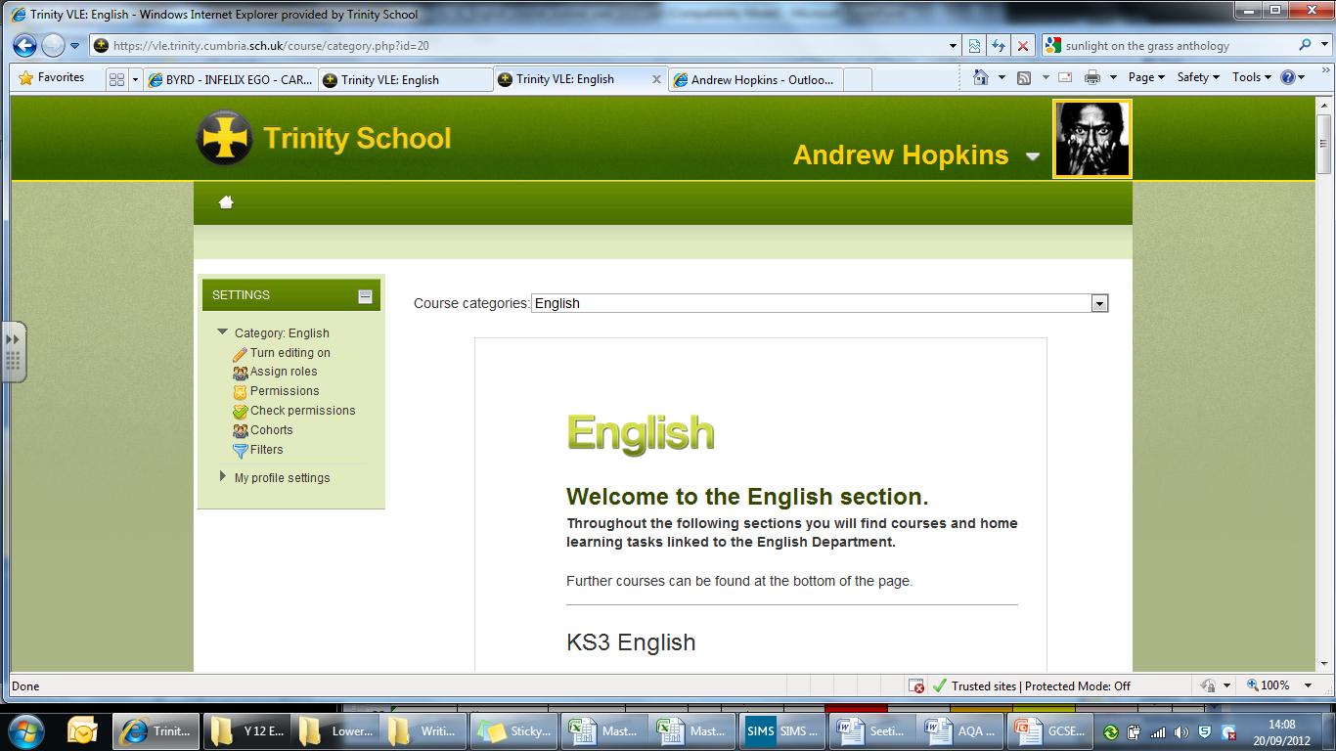
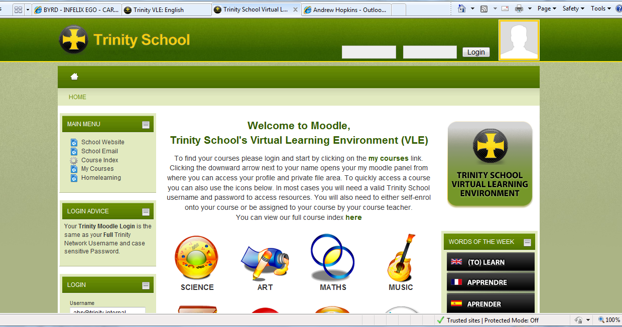
Moodle – http://vle.trinity.cumbria.sch.uk
Scroll Down

Slide 12
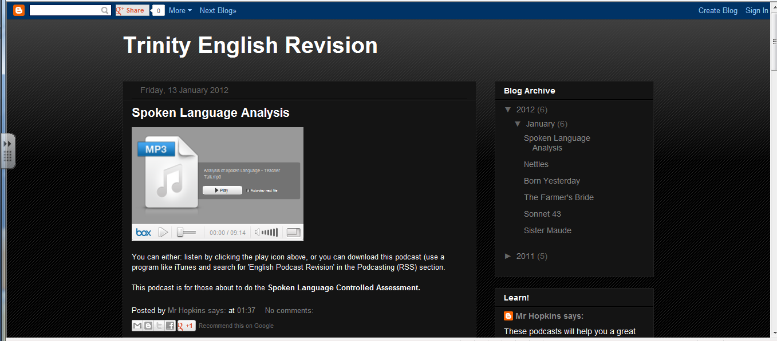
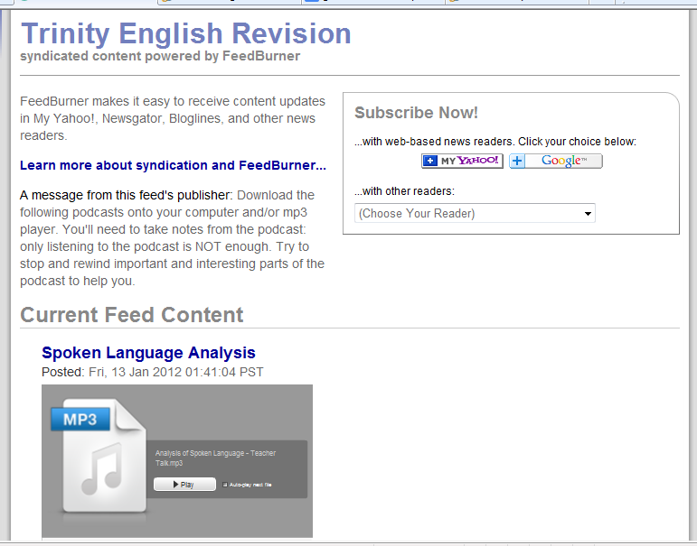
Podcasting – http://www.trinityenglishrevision.blogspot.co.uk/ OR http://feeds.feedburner.com/TrinityEnglishRevision

Slide 13


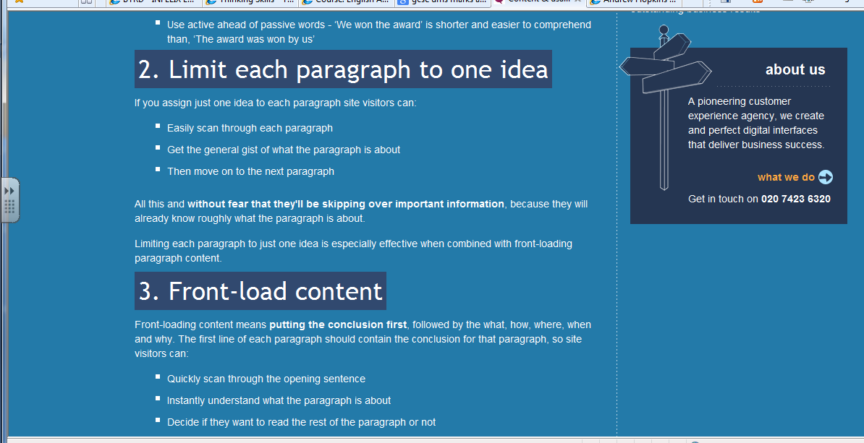
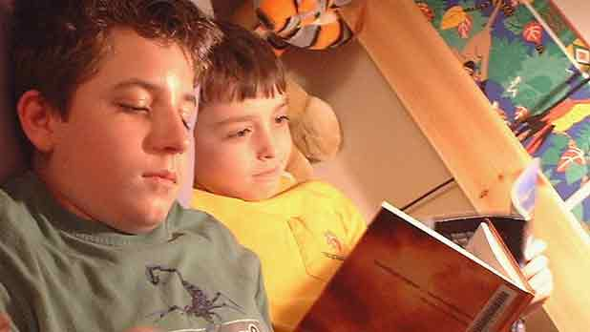
Unit 1: Reading & Writing Non Fiction
40%

Slide 14

Unit 2: Presenting, Discussing/listening, Role-play
Formal
Informal
20%

Slide 15



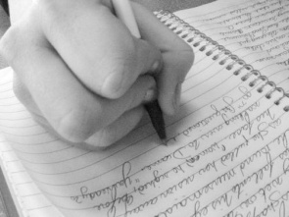

Unit 3 - Understanding written texts and writing creatively
Formal
Informal
40%

Slide 16
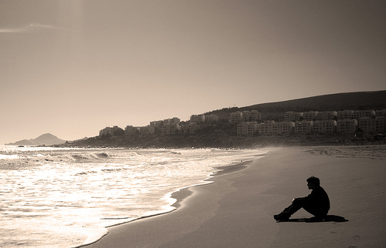
Controlled Conditions Coursework
40%

Slide 17
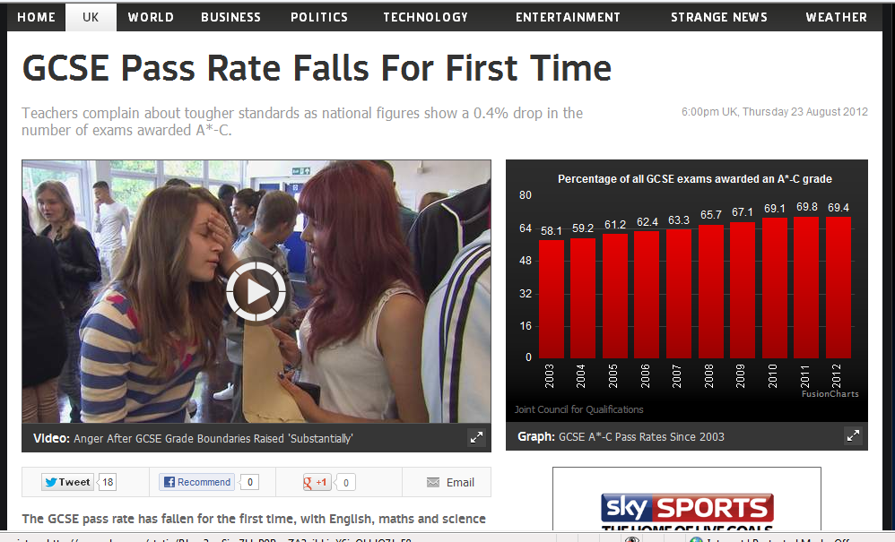
I’m Sure You’ve Heard...

Slide 18



So...
Start now...
Be an independent learner...
Use all the resources available...

Slide 19
GCSE English or English Language & English Literature

