Slide 1
Year 11 Revision

Slide 2
Clip 1

Slide 3
The Reluctant Learner

Slide 4
Learning Objective
To consider practical tips for effective revision

Slide 5
Learning Outcome
You will have had a chance to reflect on what revision style suits you best and will have produced at least one revision resource for Science.

Slide 6

Activity 1 – Word Recall

Slide 7





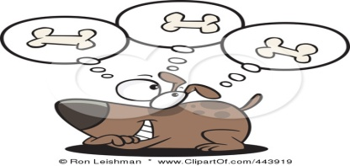
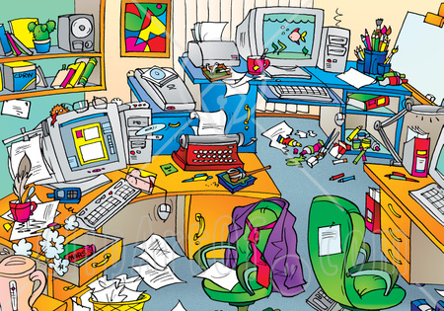


Causes of Poor Concentration
Vocabulary Difficulties
Conceptual Difficulties
Inappropriate Reading Speed
Distraction
Poor Organisation
Lack of interest
Lack of motivation

Slide 8

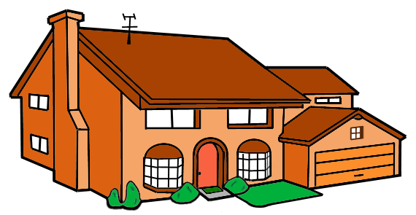
Speed read ing has be en found to be bet ter for understand ing than slow read ing

Slide 9
It has been discovered that the human brain
with the help of its eyes takes in information
far more easily when the information
is conveniently grouped in meaningful bundles

Slide 10
Activity 2 – What type of learner are you?

Slide 11
Poem
I must go down to the seas again
To the lonely sea and the sky
I left my shirt and pants there
I wonder if they are dry.
                Spike Milligan

Slide 12
How did you do?

Slide 13
Booklet
Choose a technique from the booklet
http://www.bbc.co.uk/schools/gcsebitesize/maps/index.shtml
Make a Science revision resource using a technique that appeals to your learning style

Slide 14
Clip 2

Slide 15
Why this today?
Maths GCSE three weeks today
Science exams January
Re-sits?
Ongoing Controlled Assessments in lots of subjects

Slide 16
Summer exams
6 months
24 weeks
120 school days
600 lessons

