Slide 1

PREPARING FOR EXAMS

Slide 2
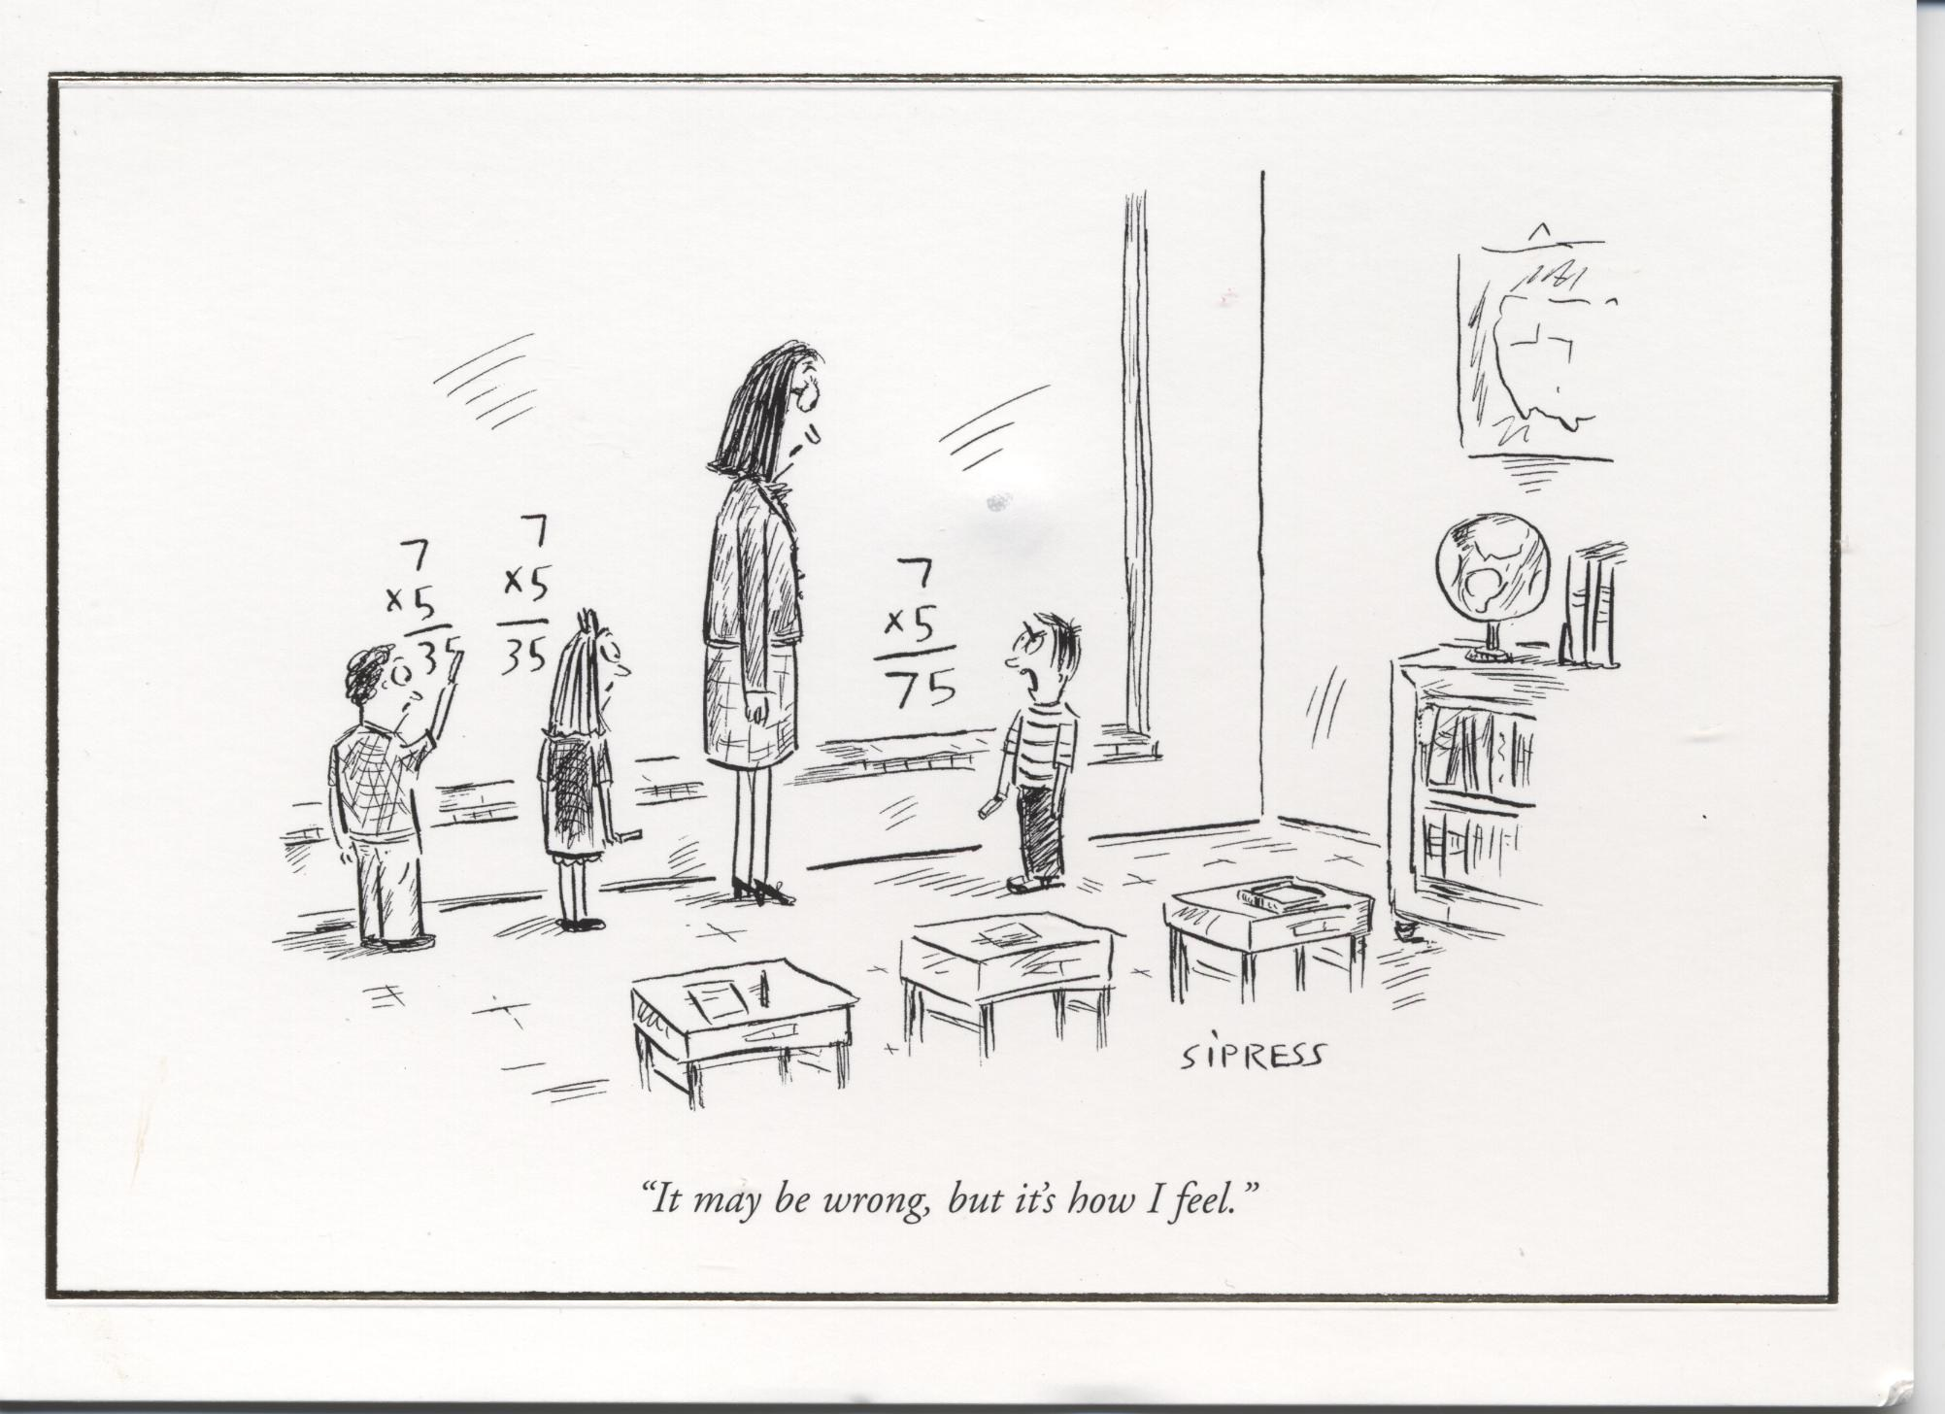

Slide 3

THE LAST LAP
Taking responsibility
Owning your learning
The partnership

Slide 4

KNOW YOURSELF
The self doubter
The perfectionist
The rebel
The excessive socialiser
The daydreamer

Slide 5
THE STRATEGY
Diet
Exercise
Water
Environment
Learning Styles
Stress Management

Slide 6
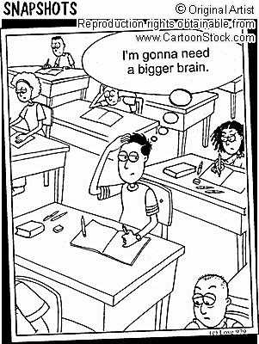

Slide 7
MANAGING STRESS
Stress and learning
Personal space
Music
Relaxation techniques
Communicate

Slide 8
HOW TO REVISE
Find the style which suits you best
Understanding is not knowing
Don’t just read your notes
Don’t start with the things you know best
Exam technique
Use a trigger

Slide 9
A MULTISENSORY APPROACH
People recall:
  10% of what they read
  20% of what they hear
  30% of what they see
  70% of what they see and hear
  90% of what they say and do

Slide 10
LEARNING STYLES
Index cards • Walkabout
Mind mapping • Visualisation
Post its • Raps/Rhythm
Dramatic monologue • Posters
Review to music • Podcasts
ICT • Study groups

Slide 11
HOW CAN YOU HELP?
Strategy
Timetable
Rewards
Confidence
Balance
Practical support
Teamwork

Slide 12
