Slide 1
Parent Workshop 14th March
Maths

Slide 2
Have a go!
Try question 25 on the tables.
If you get stuck open the envelopes in order!

Slide 3
Getting unstuck
Encourage students not to give up – no blank pages!
Where is help available?
  BBC bitesize
  Revision guides
  You tube
  www.mymaths.co.uk
  www.edexcel.com
  Teacher help
  Sixth form mentors

Slide 4
Building confidence in Maths
The “fall back” position
  Share £48 in the ratio 5 : 3
  2. 1 + 3
  3 5

Slide 5
It’s not like it used to be!
Subtraction
Multiplication
Division

Slide 6
Unstructured questions
A school only has pupils in Year 7, Year 8 and Year 9.
The table shows information about pupil absence on one day.
The target for daily attendance is 93% or more for the whole school.
Did the school meet the target that day?
...........................................................................................................................................
...........................................................................................................................................
...........................................................................................................................................
...........................................................................................................................................
...........................................................................................................................................
(5 marks)
 | Year 7 | Year 8 | Year 9
Number of pupils in year group | 380 | 400 | 420
Number of pupils absent | 28 | 32 | 36

Slide 7
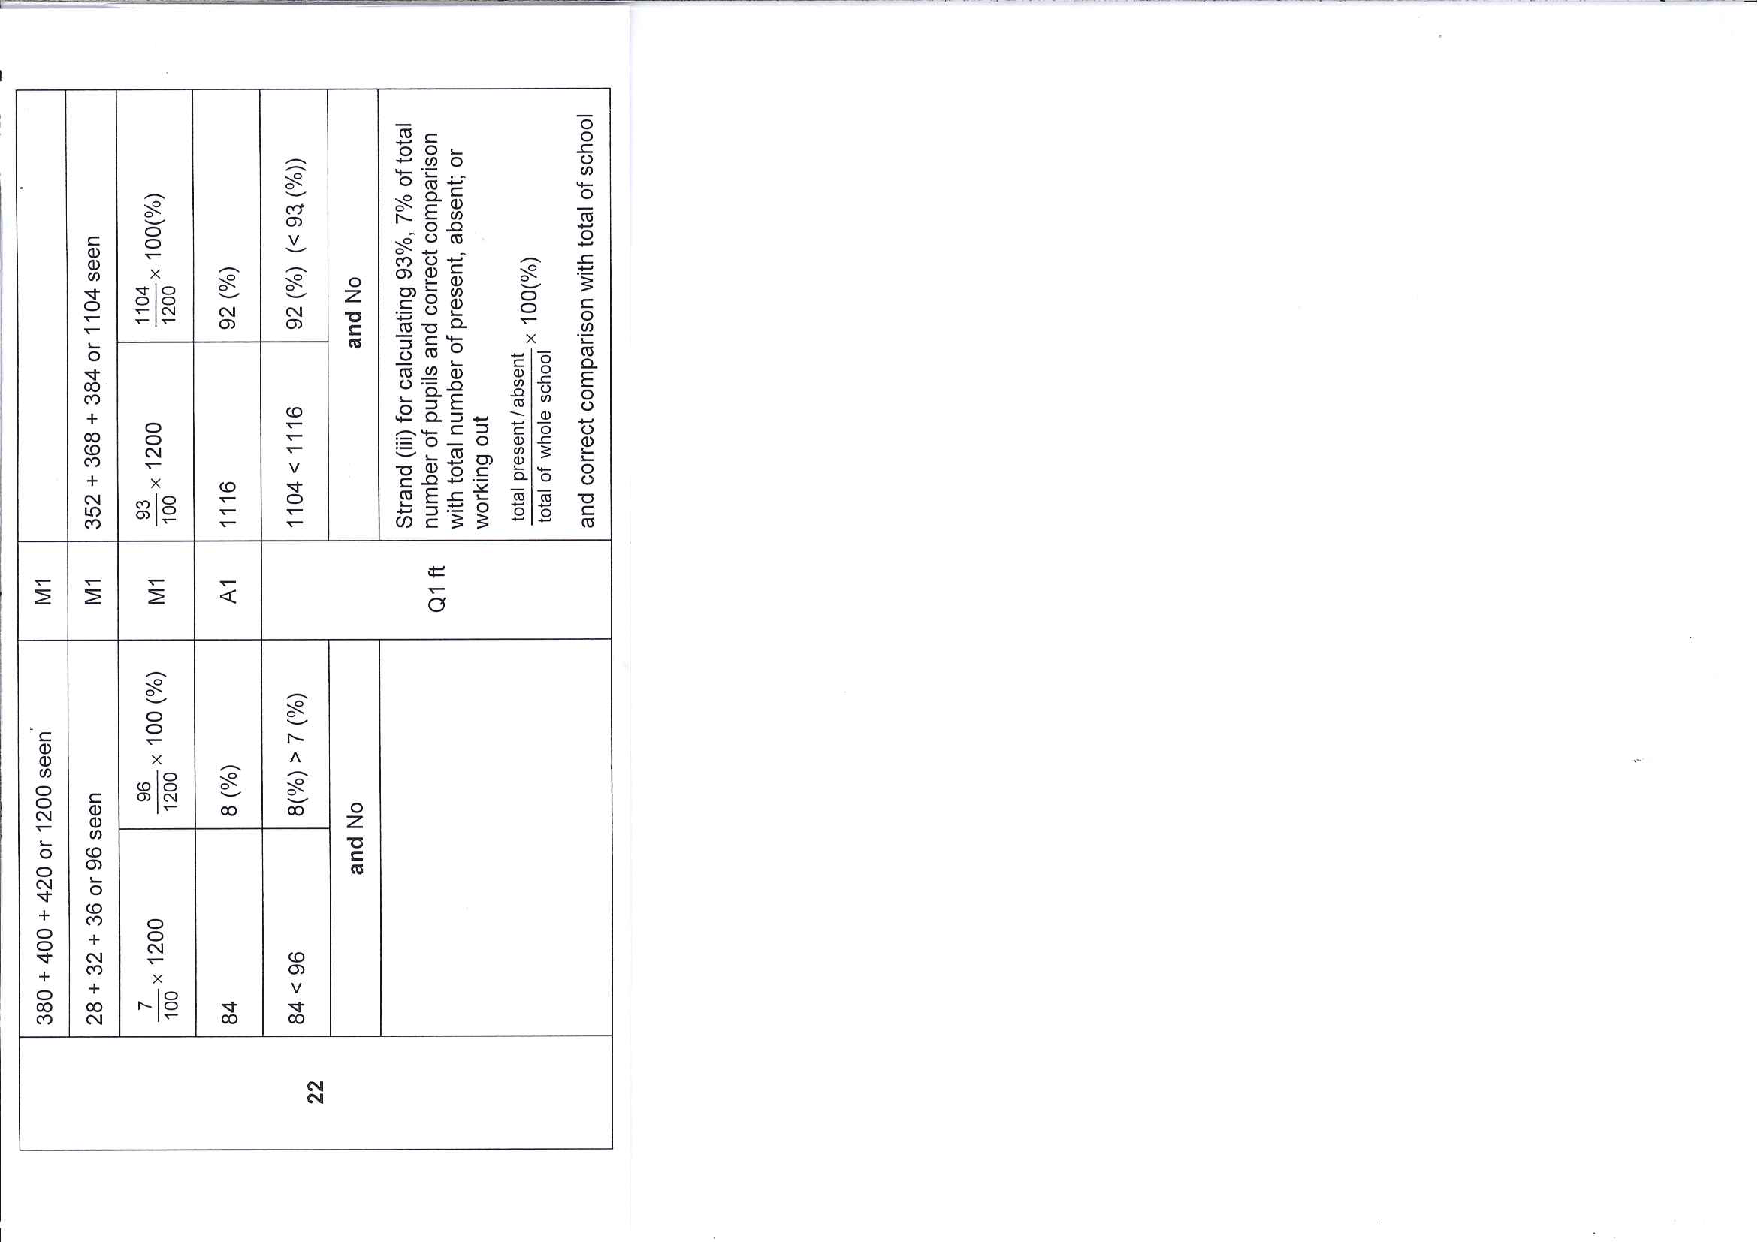

Slide 8
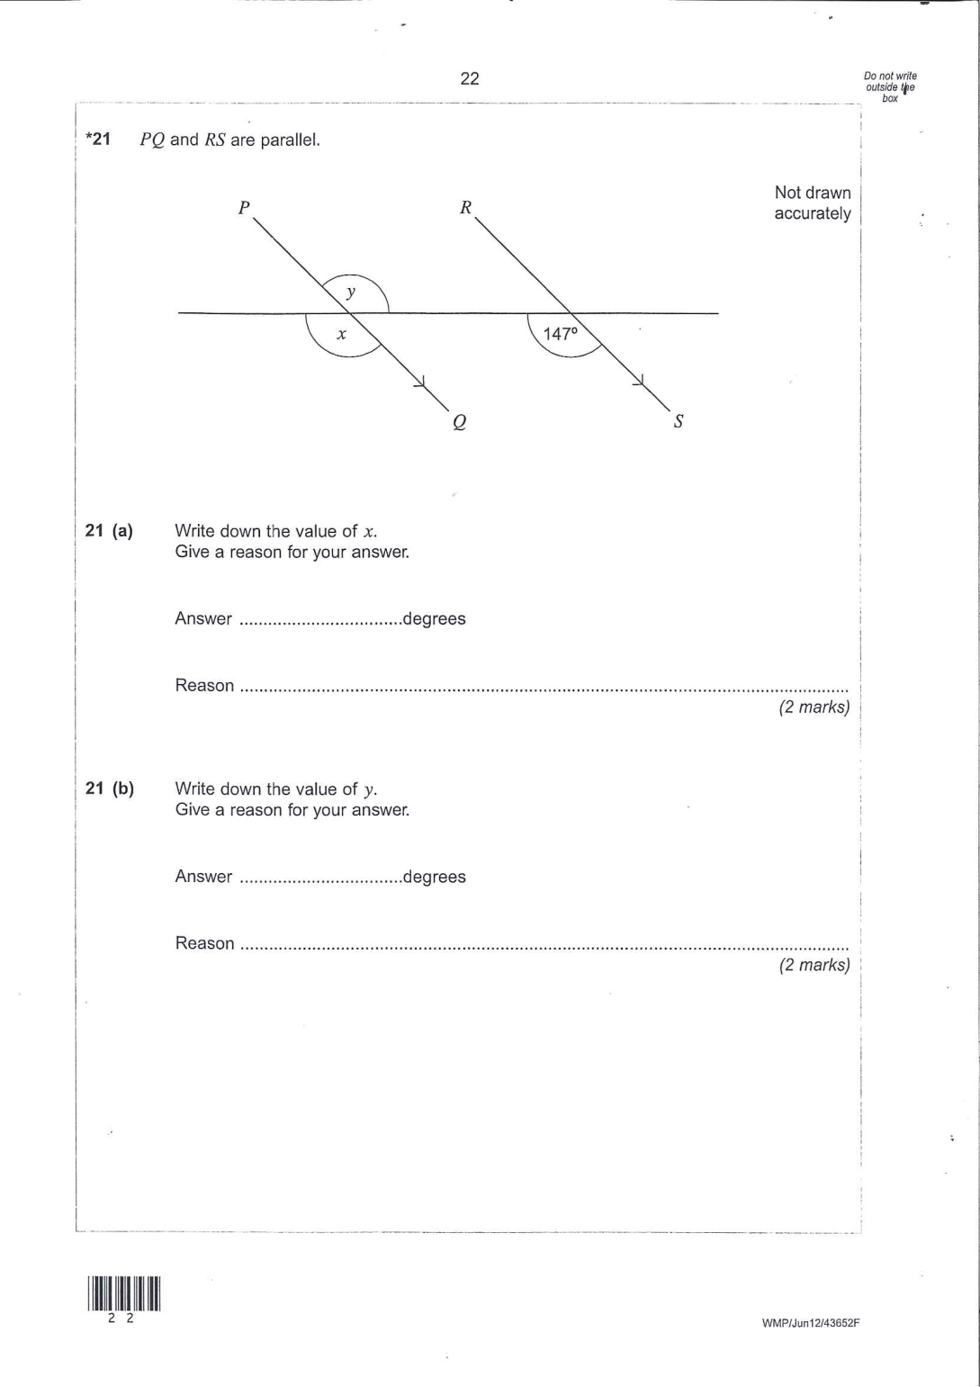
Star Questions

Slide 9
Exam board websites
*www.edexcel.com
www.aqa.org.uk
www.ocr.org.uk
Look up past papers on any site to find more questions like these – look for the most recent papers.

