Slide 1
History Makers

Slide 2
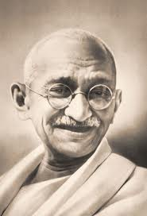
Mahatma Gandhi
Gandhi was the leader of the Indian nationalist movement against British rule. His doctrine of non-violent protest to achieve political and social progress has been hugely influential.
Gandhi worked throughout his life against discrimination, and to make his world a more peaceful place.
Yet on 30th January 1948 Gandhi was assassinatied.
“You must wish to be the change you wish to see in the world”

Slide 3
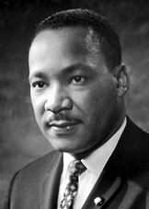
Martin Luther King Junior.
Martin Luther King, Jr. was an American clergyman, activist, and leader in the African-American Civil Rights Movement. He is best known for his role in the advancement of civil rights using nonviolent civil disobedience.
Martin Luther King, Jr. fought for equality for Black people in the United States using non-violent protests. King’s protest helped change rasist laws in the U.S.
On April 4th 1968 Martin Luther King, Jr was assassinated.
“The ultimate tragedy is not the oppression and cruelty by the bad people but the silence over that by the good people. “

Slide 4
“I have a dream...”
Both Mahatma Gandhi and Martin Luther King Jr were men who protested using non-violent methods for equality in their home countries. Both were assassinated because of their actions.
Why do you think that they were assassinated?
Do you think either one of them would have chosen not to fight for what they believed in if they had known that they would die for it?
Do you believe in anything enough to fight for it?

Slide 5
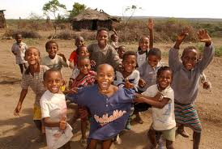
Savannah Bukant
As a high school senior Savannah Bukant was faced with the task of completing a community experience project.. She decided to raise the funds to start a cottage for orphaned children in Ethiopia. The amount needed was daunting, and the time needed to raise it was almost enough to make Savannah consider a different project. But she said yes—to raising $15,000 in three months!
Savannah dove into the project, and during the next three months, she held a walk-a-thon, benefit concert, car wash, letter campaign, and church presentation! At the end of those three months, she had raised $18,000 to help orphans in Ethiopia!
Savannah maintains that with passion, support, and hard work, anyone can make a difference.
“If you want to change the world, go ahead and change the world. Nobody is stopping you. You may encounter dilemmas or opposition, but push past them.”

Slide 6
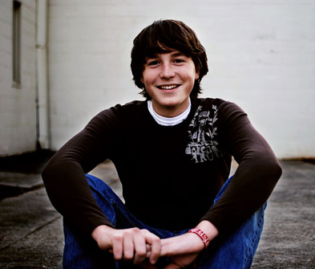
Zach Hunter
Zach Hunter was just 12 years old when he learned that slavery wasn’t just something that existed in his history books. The things Zach learned about human rights violations didn’t just make him angry. They drove him to act.
So the seventh grader launched Loose Change to Loosen Chains, a campaign designed to raise money to abolish slavery, a problem facing 27 million people in the world today. His school and youth group raised more than $8,500.
But Zach wasn’t finished. In the six years since Zach decided to change the world, he has written three books and travels the globe, speaking at schools, music festivals, and conferences about fighting modern day slavery.
And the Loose Change to Loosen Chains movement has spread across the country, creating today’s generation of abolitionists.
“Working together, our generation CAN make a difference. Don’t wait for someone else. Don’t wait for someday. Because YOU are the someone, and TODAY is the day.”

Slide 7
Never to young...
Zach and Savannah realised that change need to happen and instead of waiting for someone else to make it happen they did it themselves.
Is there anything you would like to see happen in the world?
What are you doing to make this change happen?
There are many reasons that people do not try to help others and make change. Often they think that they cannot, or are worried that if they try they might fail, or they might just not know where to start.

Slide 8
What you can do now
Want to know how to get involved in changing the world today?
Different charities have ideas on their websites about what you can do to get involved.
Design a poster to raise awareness about an issue that you think should change.
Write a letter to your MP asking them to get the government to do something about an issue that you care about.
Hold a fundraising event to raise money to support a cause.
There are plenty of local charities who need practical support on a regular basis – offer you time and get some work experience!

